Slide 1
Theorem Proving
Three important concepts for Logical Inference

Slide 2
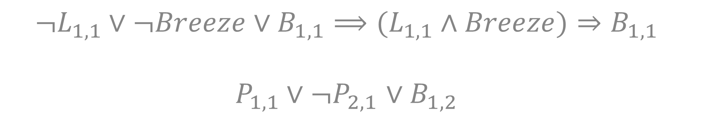
Horn Clauses
A disjunction in which at most one literal is positive
Equivalent in form to an implication
Example
$$¬L_{1,1}∨¬Breeze∨B_{1,1}⟹(L_{1,1}∧Breeze)⇒B_{1,1}$$
$P_{1,1}∨¬P_{2,1}$ $∨B_{1,2}$

Slide 3
Inference Algorithms:
Forward and Backward Chaining

Slide 4
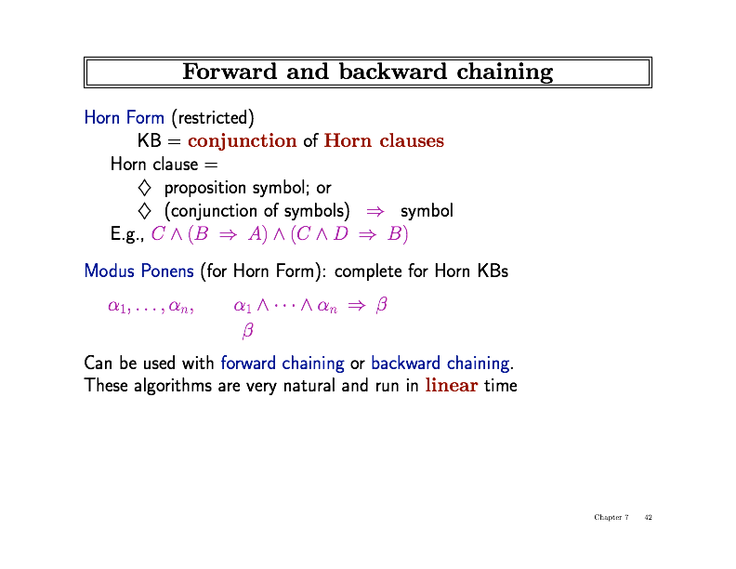

Forward and Backward Chaining
Restrict sentences to be written a particular way
Only need one inference rule in your search for entailment

Slide 5
Forward and Backward Chaining

Slide 6
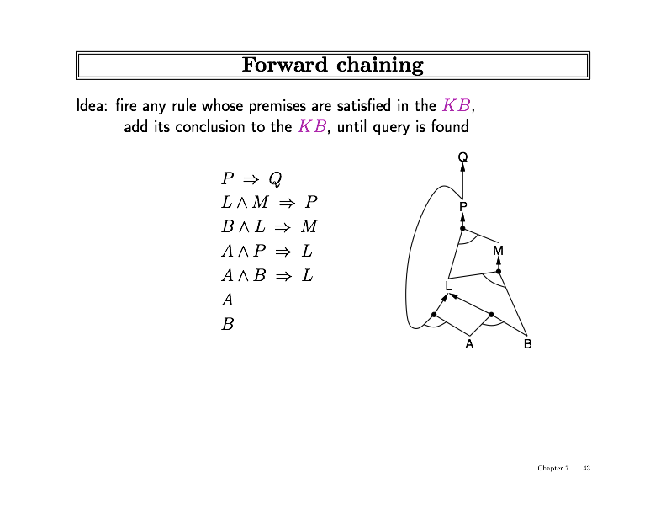
Forward Chaining

Slide 7
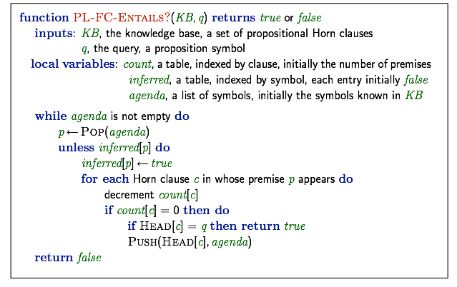
Forward Chaining

Slide 8
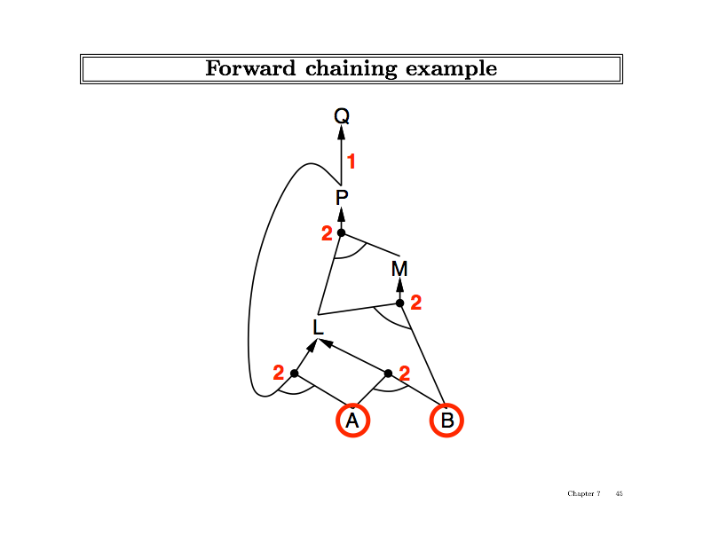

Slide 9
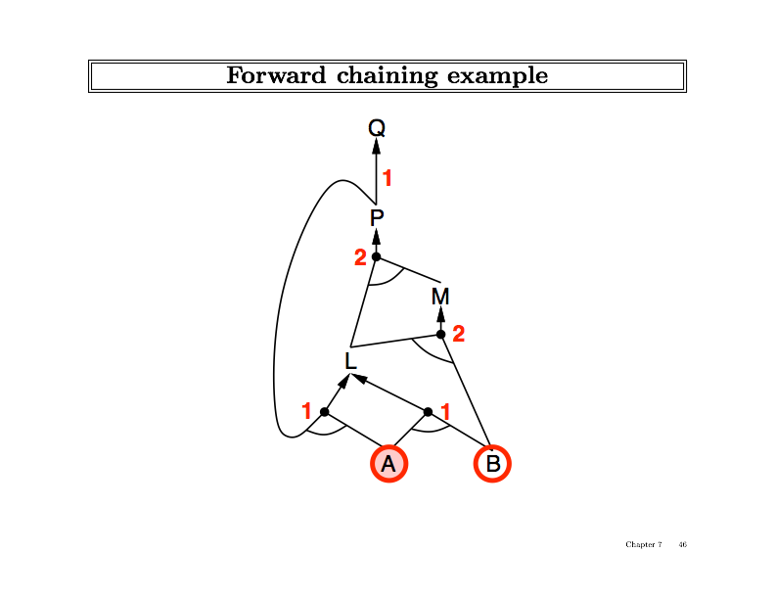

Slide 10
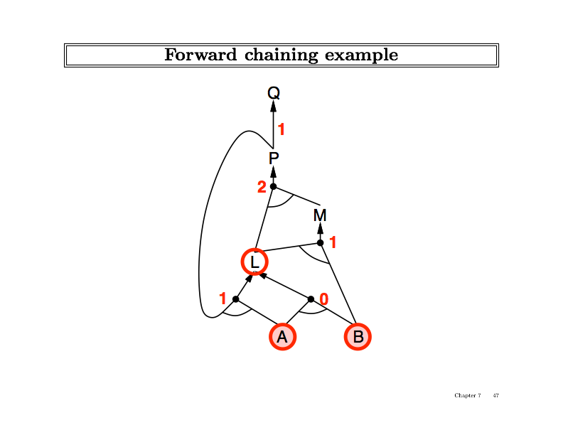
L

Slide 11
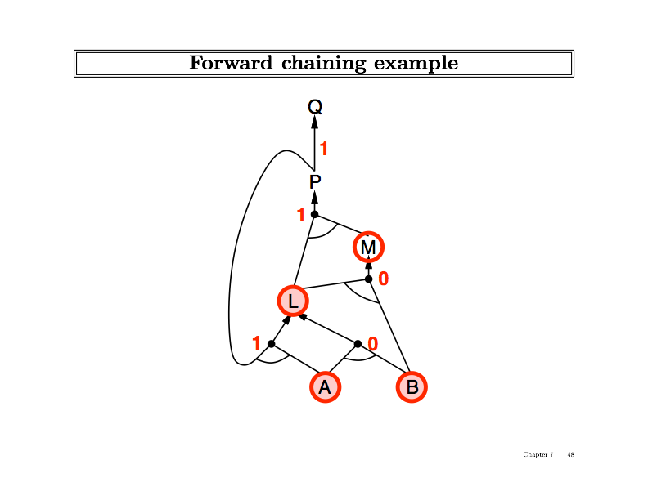
L

Slide 12
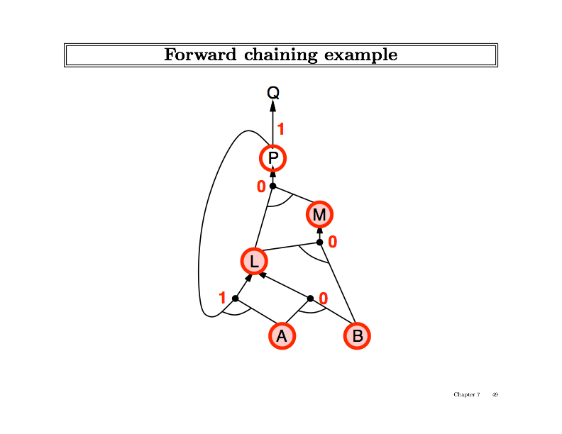
L
M

Slide 13
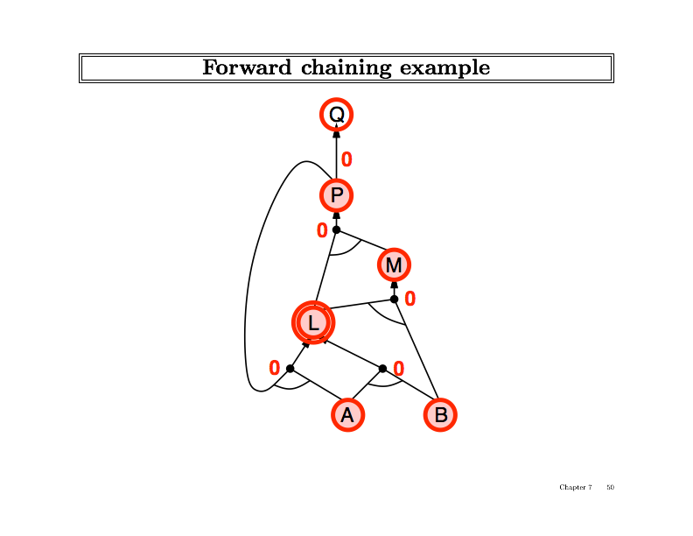
L
M
P

Slide 14
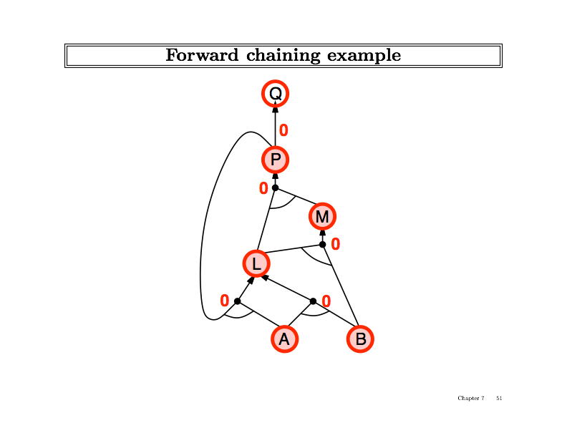
L
M
P

Slide 15

L
M
P
Q

Slide 16
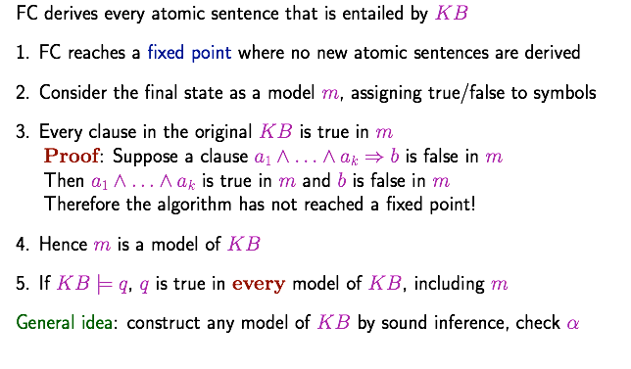
Proof of Completeness

Slide 17
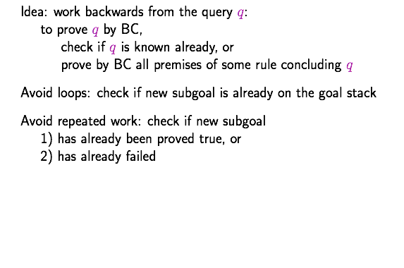
Backward Chaining

Slide 18
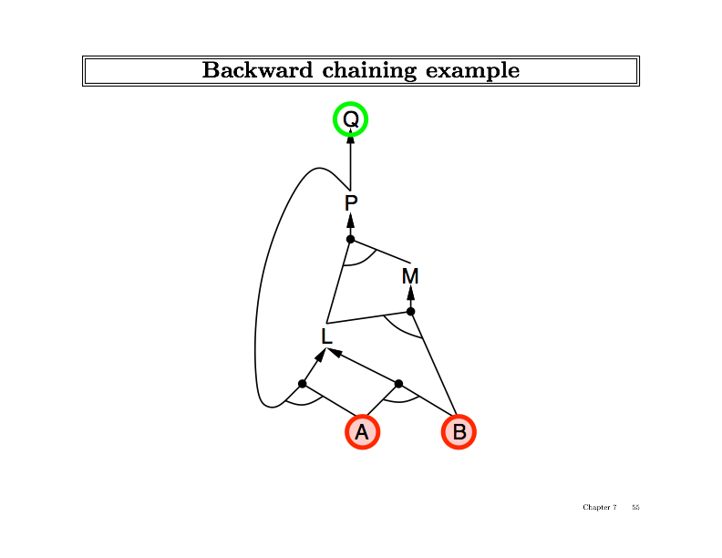

Slide 19
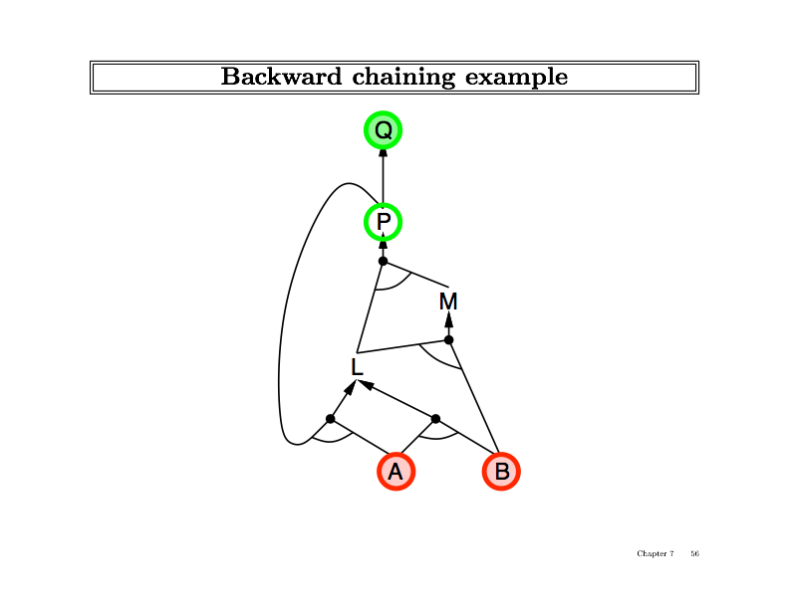

Slide 20
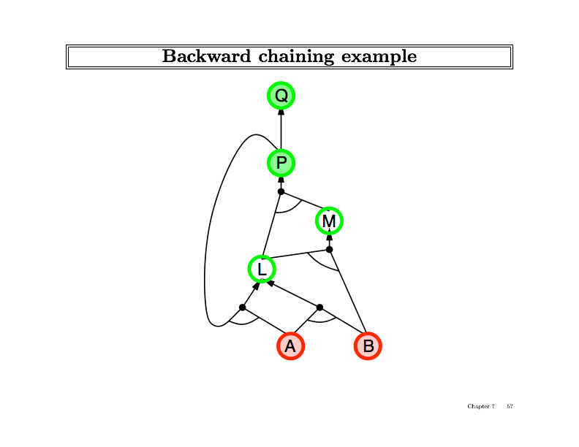

Slide 21
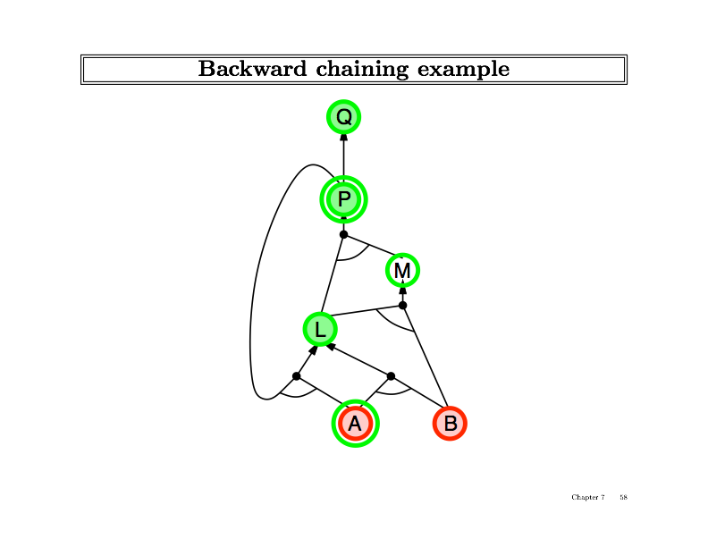

Slide 22


Slide 23
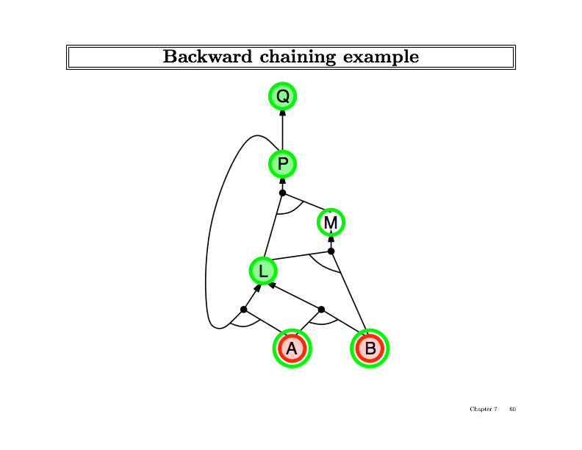

Slide 24
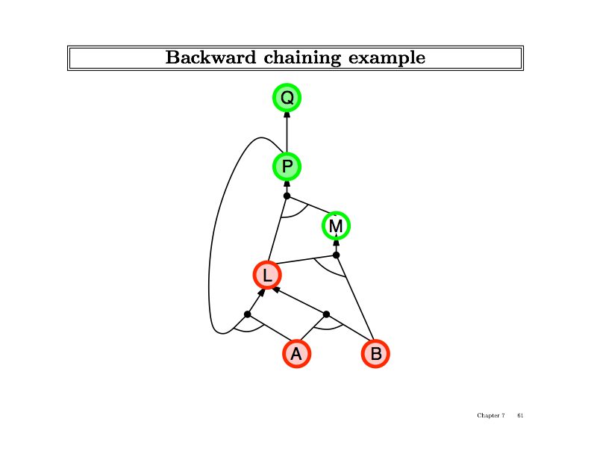

Slide 25
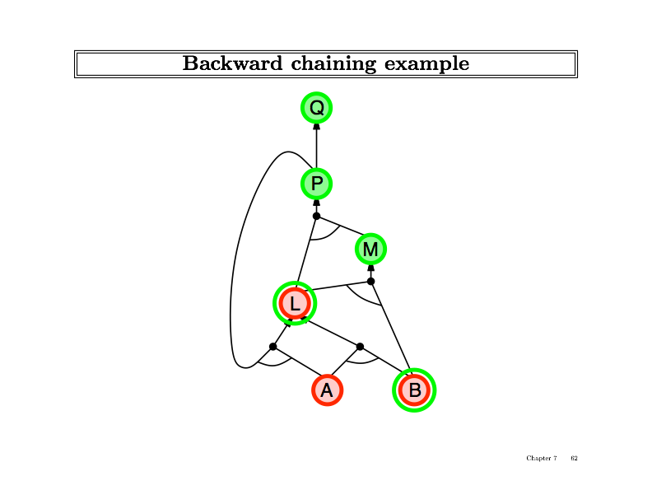

Slide 26
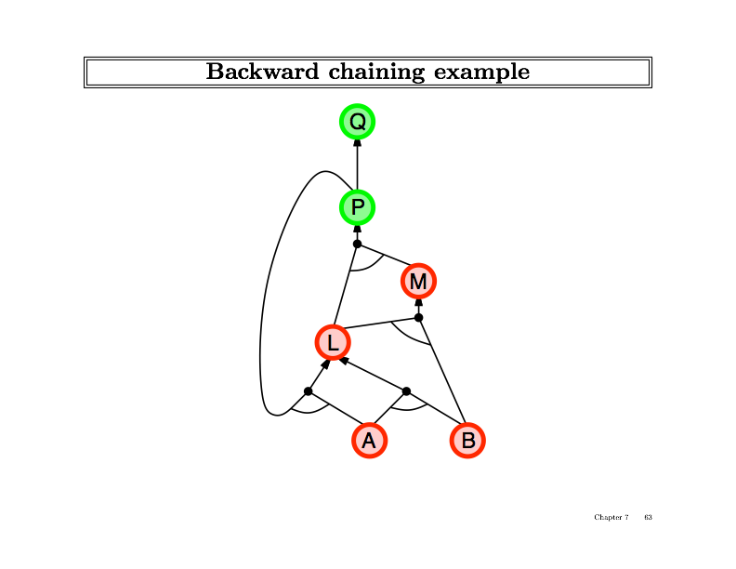

Slide 27
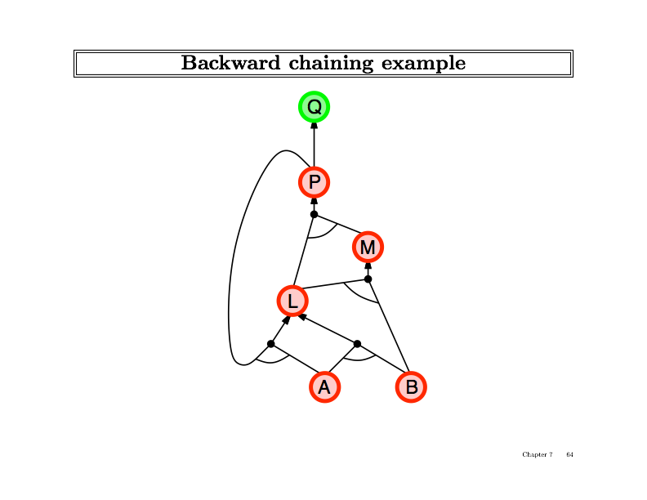

Slide 28
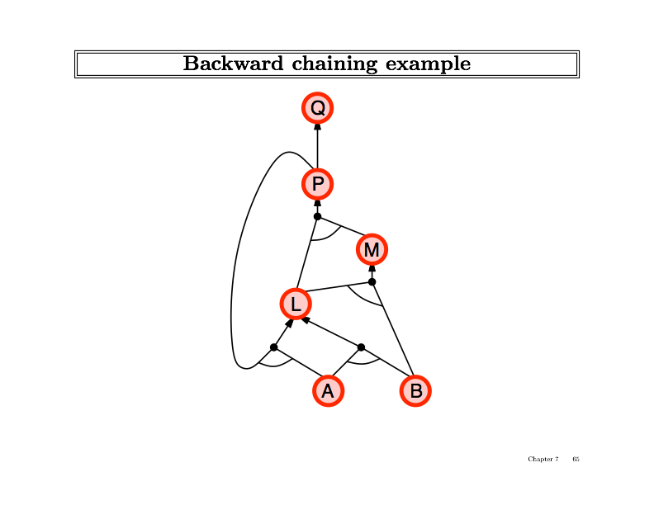

Slide 29
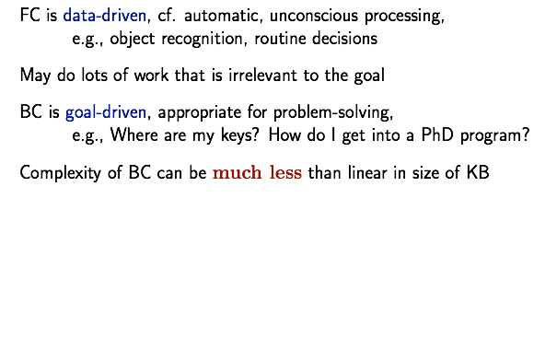
Forward vs. Backward Chaining

Slide 30
Inference Algorithms:
Resolution

Slide 31
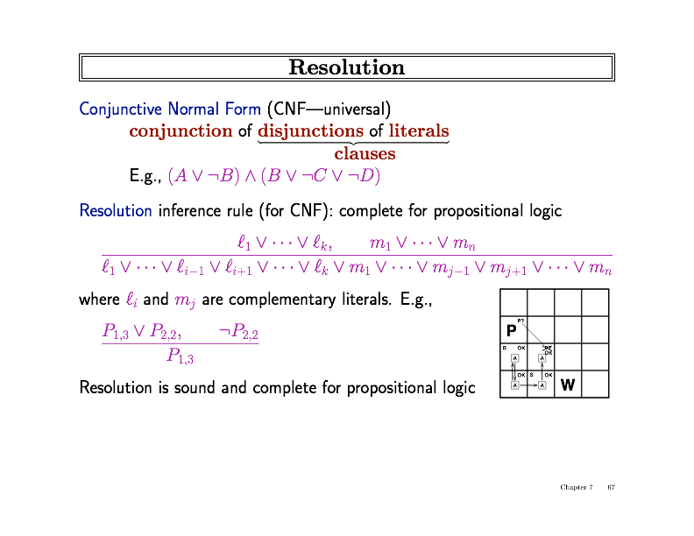
Resolution

Slide 32
Resolution

Slide 33
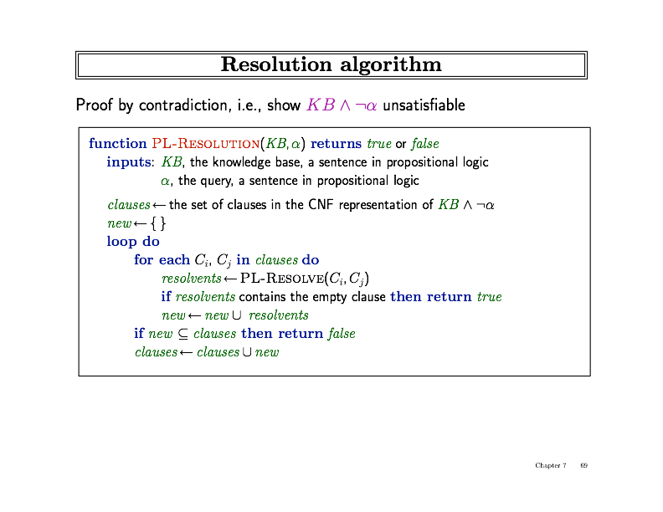
Resolution Algorithm

Slide 34
Resolution Algorithm

Slide 35
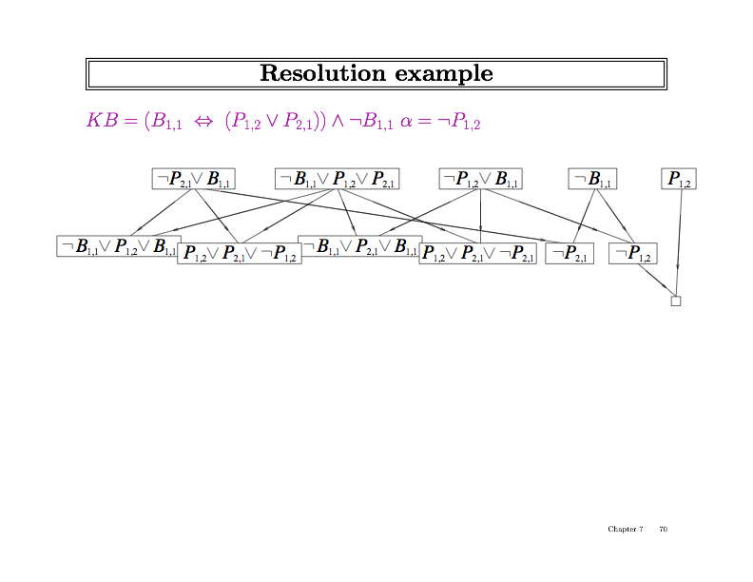
Resolution Example

Slide 36
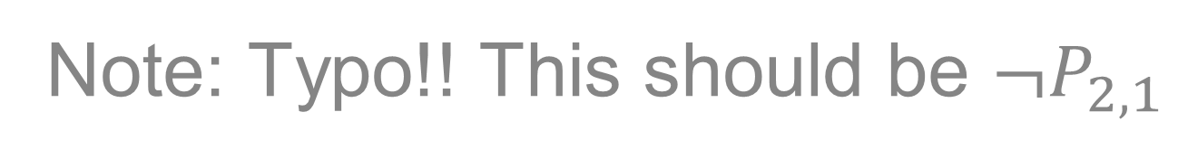
Resolution Example
Note: Typo!! This should be $¬P_{2,1}$

Slide 37
Resolution Example
Note: Typo!! This should be $¬P_{2,1}$

Slide 38
Resolution Example
Note: Typo!! This should be $¬P_{2,1}$

Slide 39
Resolution Example
Note: Typo!! This should be $¬P_{2,1}$

Slide 40
Resolution Example
Note: Typo!! This should be $¬P_{2,1}$
Contradiction, therefore our sentence is entailed.

